Slide 1
Object Oriented Programming Lecture -5
Chapter 14, D.S. Malik, C++ Programming, 5th edition
Chapter 8, Dietel & Dietel, C++ how to Program, 7th edition
Object oriented Programming
Spring 2024

Slide 2
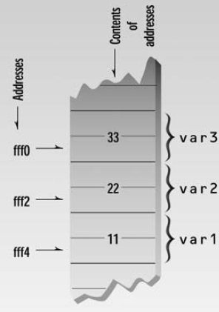
The Address-of Operator &
REVIEW
#include <iostream> using namespace std; int main() { int var1 = 11; int var2 = 22; int var3 = 33; cout <<&var1<<“\n”; cout<<&var2<<“\n”; cout<<&var3<<“\n”; return 0; }
Each location in memory has some address and some content(Value)

Slide 3
What is a pointer?
REVIEW
A variable that can hold address
Declaration:
dataType * pointer name;
int * p;
int n=10;
p=&n;
Asterik means pointer to
dataType of a pointer is the dataType of the variable this pointers is pointing to.
0x100
0x100
10
p
n

Slide 4
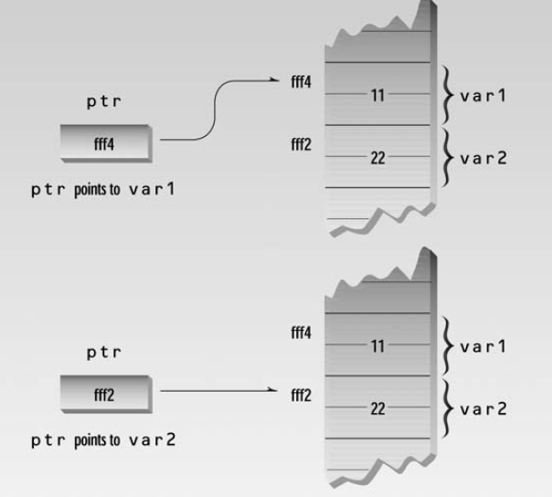
REVIEW
int main()
{
int var1 = 11;
int var2 = 22;
cout << &var1 << &var2 ;
int* ptr;
ptr = &var1;
cout << ptr << endl;
ptr = &var2;
cout << ptr << endl;
return 0;
}

Slide 5
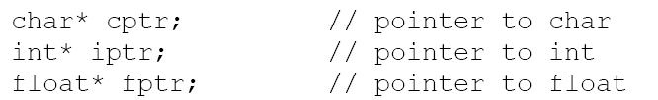


Examples
// p is pointer and q is not a pointer
// both p and q are pointers

Slide 6
Constant Pointer
Its value cannot be changed
int * const ptr = & x;
ptr= &y … NOT ALLOWED

Slide 7
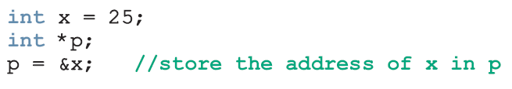

Dereferencing operator *
The * operator is called indirection operator or dereferencing operator
It refers to the object to which its operand (i.e., pointer) points
0x100
0x100
25
p
x
Output: 25
0x100
*p is equivalent to x
*p=21
0x100
21
p
x

Slide 8
cout<<x is equivalent to cout<<*p
x=x+1; is equivalent to *p = *p +1

Slide 9
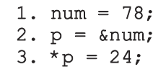
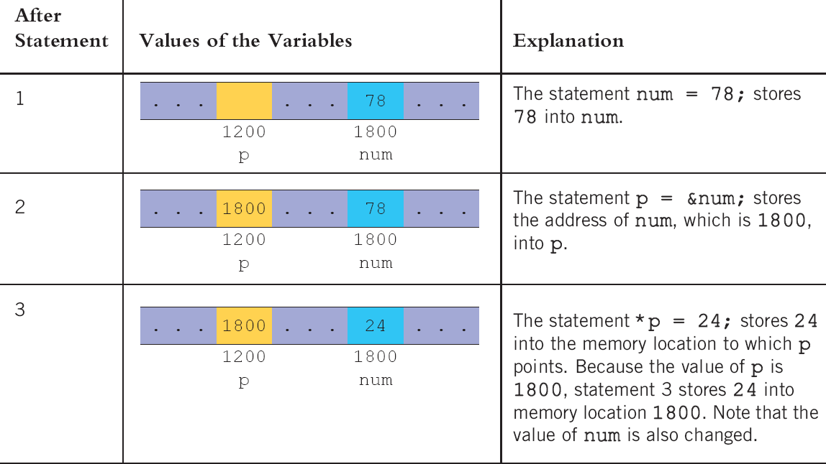
Example

Slide 10
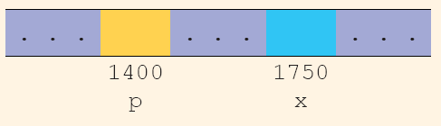

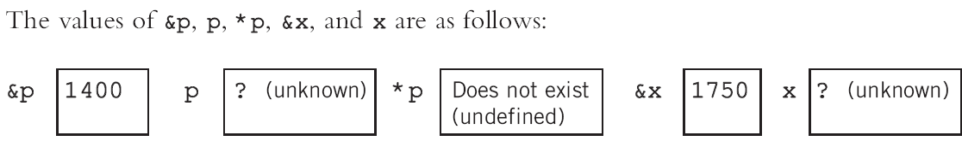

Example
Now following statements have been executed:
What are the values after third statement is executed?

Slide 11
Exercise

Slide 12
 | p | *p | q | *q | x(0xfff0) | y(0xfff4)
int *p = NULL;
int x = 1,y=2;
int *q = NULL;
p = &x;
(*p)++;
q = &y;
x = 5 + y;
*p = *p+2;
y = y * *p;
y = y + *q;
p = q;
y++;

Slide 13
 | p | *p | q | *q | x(0xfff0) | y(0xfff4)
int *p = NULL; | N | ? | ? | ? | ? | ?
int x = 1,y=2; | N | ? | ? | ? | 1 | 2
int *q = NULL; | N | ? | ? | N | 1 | 2
p = &x; | fff0 | 1 | ? | N | 1 | 2
(*p)++; | fff0 | 2 | ? | N | 2 | 2
q = &y; | fff0 | 2 | fff4 | 2 | 2 | 2
x = 5 + y; | fff0 | 7 | fff4 | 2 | 7 | 2
*p = *p+2; | fff0 | 9 | fff4 | 2 | 9 | 2
y = y * *p; | fff0 | 9 | fff4 | 18 | 9 | 18
y = y + *q; | fff0 | 9 | fff4 | 36 | 9 | 36
p = q; | fff4 | 36 | fff4 | 36 | 9 | 36
y++; | fff4 | 37 | fff4 | 37 | 9 | 37

Slide 14
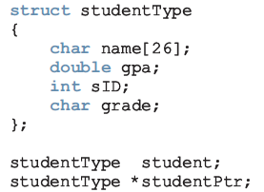

Pointer and structs

Slide 15
Pointers & Arrays

Slide 16
Array
Array name is an address
int array[10]={0,1,2,3,4,5,6,7,8,9};
cout<<array;
//What should be output?
cout<<*array;
Array is a constant pointer
We cannot point array to another variable
0 | 1 | 2 | 3 | 4 | 5 | 6 | 7 | 8 | 9
array

Slide 17
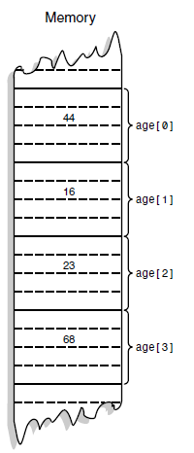
int age[4];
age+0
age+1
age+2
age+3

Slide 18
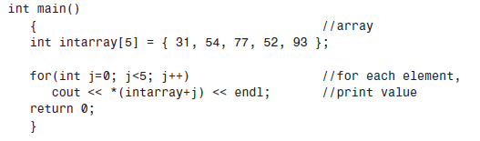
[ ] operator is also a dereferencing operator
It is equivalent to *(intarray+j)

Slide 19
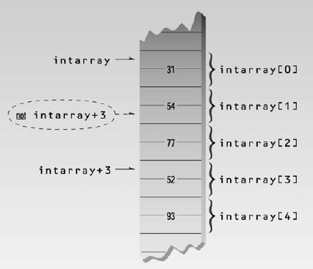

Slide 20
Pointer Arithmetic
When something is added to pointer, compiler checks the data type
int array[10];
*(array + 1) //access second element of array it is equivalent to array[1]
*(array + j) actually equal to
array + (j* sizeOf dataType)

Slide 21
Accessing array with pointer
int array[5]={10,12,14,16,18};
int *ptr;
ptr=array; // same as ptr=&array[0];
ptr=&array ; //wrong
ptr=&array[2];
*ptr=*ptr + 3;
ptr++;
cout<<*ptr;
cout<<*(ptr+1);
cout<< * (ptr-1);
ptr--;

